Slide 1
Warzone Buildv3.0
Muhammad Adnan Asad
Sumit Sharma
Pranaykumar Chauhan
Darshansinh Dilipsinh Devda
Dhruvkumar Parmar
Dhruv Patel

Slide 2
Goal
Refactor your code to use the Adapter pattern to enable the application to read or write from or to a file using the “conquest” game map format in addition to the existing “Domination” map format.
Refactor your current user-driven player code so that the implementation of the Player’s issueOrder() method’s behavior is using the Strategy pattern.
Introduce two new game modes Single game mode and tournament game mode.
Add functionality to save and load a game.
In addition, the code should be well-documented using Javadoc API documentation and verified using -XDoclint and the project must be tested thoroughly using Junit.

Slide 3
ARCHITECTURE

Slide 4
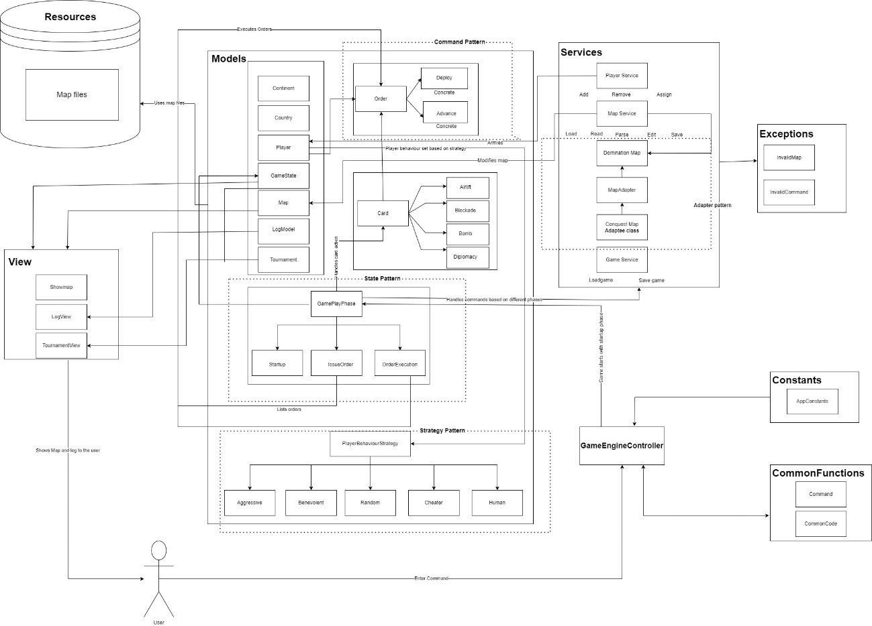

Slide 5
Models
• Player: This class controls all of the continents, nations, orders, and armies that each Player object has.
• Order: This class handles the order instructions, the source and destination country, and the number of armies to move.
• GameState: Manages the Player and Order objects, as well as the list of orders that have yet to be performed.
• Map: Manages the Country and Continent objects, as well as validating the map by examining the relationship between existing nations and continents.
• Continent: Manages all of the continents as well as their bonus values. In addition, the Country object is connected to the Continent object in order to map all of the nations that exist in the Continent.
• Country: Manages all of the Countries, as well as the amount of troops stationed in each of them, as well as the Countries next to it.

Slide 6
Models
• LogEntryBuffer: Implemented observer pattern for logging messages in different gameplay stages.
• Tournament: Tournament class handles the tournament gameplay which will be played automatically by different Player Strategies
• GamePlayPhase.java: (State Pattern Implementation)
IssueOrderPhase: Manages the issue order phase of the gameplay and handles the commands accordingly.
StartupPhase: Manages the startup phase of the gameplay and handles the commands accordingly.
OrderExecutionPhase: Manages the order execution phase of the gameplay and handles the commands accordingly

Slide 7
Models
• Order: (Command Pattern Implementation)
Advance: Advancing the armies of the player from one country to another country. Advance order is executed only if the target and source territories are adjacent to each other.
Deploy: Deploying a few armies to one of the current player’s territories.

Slide 8
Models
Card Implementation
Bomb: Manages the bomb card logic wherein the target country loses half of their army units when this card this used by the player on the enemy territory.
Blockade: Manages the blockade card logic wherein one of the player’s territory becomes neutral and triples the armies on the same territory.
Airlift: Manages the airlift card logic wherein the player can move any number of armies from one of his territories to another, even if they are not adjacent.
Diplomacy: Manages the diplomacy card logic wherein the current player and the enemy player will not be able to attack each other until the end of the existing turn.

Slide 9
Models
PlayerBehaviourStrategy
AggressivePlayer: This class implements and handles the main logic of Aggressive Player who will gather all his armies, attacks from his strongest country and deploys armies to maximize his forces on one country.
BenevolentPlayer: This player will solely focus on defending his territories and will never attack
CheaterPlayer: Cheater Player will initiate attacks during the issue order phase and will double his armies on the territories that consists of enemy neighbours.
HumanPlayer: This class manages the logic of receiving commands from the user and playing the game accordingly.
RandomPlayer: This class implements the logic of Random Player who will randomly choose a country to attack from, using random number of armies and then attacking any random enemy country.

Slide 10
View
ShowMap: When the user chooses the showmap command in the GamePlay State, it shows the current state of the Map and the overall existing Map when in the EditMap phase.
Logger: Writes logs to the log file which consists of all the logs derived from the Log Model implementation.
TournamentView: Displays the whole Tournament Gameplay.
Controller
GameEngineController: This class is in charge of starting the gameplay and initiates the game with the startup phase and handles the command processing logic.

Slide 11
Services
MapServices: This is where the basic logic for handling the state of the Map is handled, as well as map load, edit, and save functionality.
PlayerServices: It allows you to add, delete, and allocate continents, nations, and armies.
GameService: Handles the services related to game such as save and load.
MapAdapter: (Adapter Pattern Implementation)
i. DominationMap: This class is used to read and write Domination Map
ii. ConquestMap: This class is used to read and write Conquest Map
CommonFunctions
Command: Receives and formats commands from the players.
CommonCode: This class handles the input files.

Slide 12
Constants
AppConstants: All static members are declared here and may be utilized at any time in the application.
Exceptions
InvalidCommand: When an invalid command is entered, it displays a relevant message to the player.
InvalidMap: When an invalid map is constructed, a relevant message is sent to the player.
Resources
Map Files: All existing and newly created.map files by users are saved and handled here.

Slide 13
Demo

